Slide 1
Gender Abuse detection
Names: Tarandeep Singh, Prayag Parashar, Praddume Attri
Group number: 47
NLP End sem project

Slide 2

Introduction/Motivation
Issue: Social media (Instagram, Twitter) enables GBV—harassment, threats, stereotypes.
Impact: Silences women/gender minorities, especially in under-resourced languages (e.g., Hindi, Tamil).
Challenge: Manual moderation is slow, inconsistent, and lacks scalability in multilingual contexts.
Example Abuses:
“Stick to the kitchen” (Entrepreneur on Twitter).
“Attention-seeker, go cover yourself” (Instagram photo comment).

Slide 3
Related Study
Focus: English-centric models for hate speech, toxicity, and cyberbullying.
Key Approaches:
Transformer models (BERT, RoBERTa) for platforms like Twitter, Reddit.
Early methods: Logistic regression (Davidson et al., 2017), socio-linguistic context (Waseem & Hovy, 2016).
Limitations:
Multilingual models (e.g., XLM-R) underperform in low-resource languages.
Challenges:
Few annotated datasets for GBV in Hindi/Tamil.
Existing work (e.g., HASOC, FIRE) focuses on generic hate speech, not gendered abuse.
Our Contribution:
Curated Dataset: Annotated GBV examples in English, Hindi, Tamil.
Specialized Model: Multilingual detection tailored to gender-based abuse.

Slide 4
Dataset Description
The dataset includes 7,638 English, 7,714 Hindi,
and 7,914 Tamil posts. Each post is anno-
tated for (1) gendered abuse in general, (2) gen-
dered abuse toward marginalized groups, and
(3) explicit/aggressive content. Labels include 1
(matches), 0 (does not match), NL (not annotated),
and NaN (not assigned).
The dataset (train.csv) contains each tweet
three times (one per label) with columns for id,
text, language, key (label type), and annotator
responses for all three languages.

Slide 5
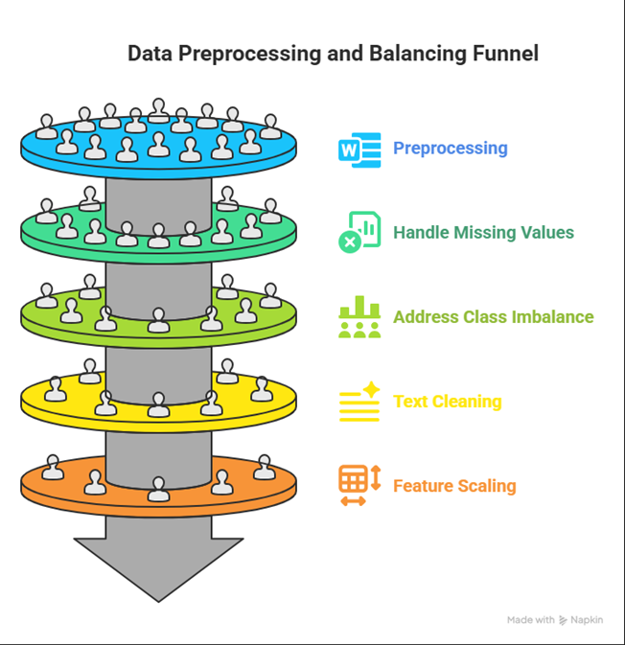
PreProcessing
Data Preprocessing & Cleaning: The dataset (loaded from CSV) underwent tokenization (handling punctuation, emojis, contractions, hashtags), text normalization, and tweet cleaning (removal of mentions, URLs, HTML entities, special characters). Missing values were either mean-imputed or dropped.
Class Imbalance & Augmentation: To balance class distribution, synonym-based data augmentation (using nlpaug’s WordNet) was applied to underrepresented tweet classes, ensuring improved generalization.
Feature Scaling & Split: Features were normalized using StandardScaler for optimal Elastic-Net performance, and the dataset was split into 80:20 for training and testing after inspecting class distributions and correlations.

Slide 6
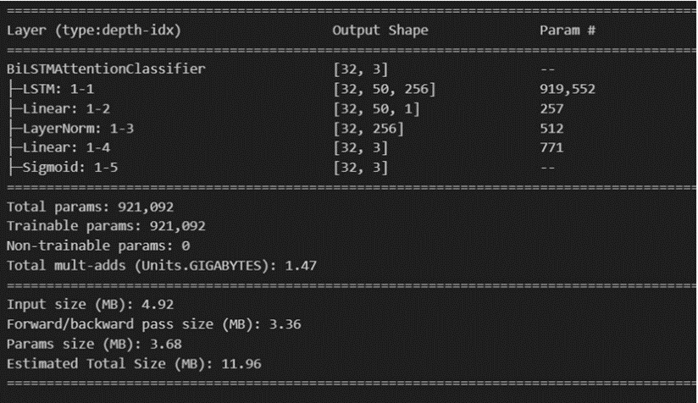
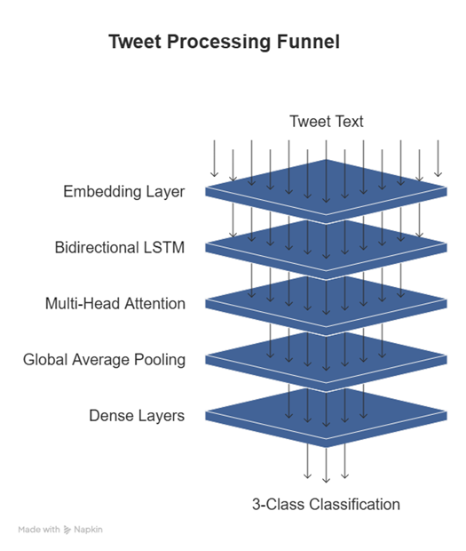
Methodology

Slide 7
Results/Findings
LSTM: Achieved moderate performance withan F1 score, precision, and recall metrics. The confusion matrix highlighted challenges in distinguishing between “hate” and “offensive”classes.
Bidirectional LSTM with FastText + At-Tention:
Addressed class imbalance usingsynonym-based augmentation. Achieved ∼81% validation accuracy, with improved per-formance on minority classes after augmenta-tion.

Slide 8
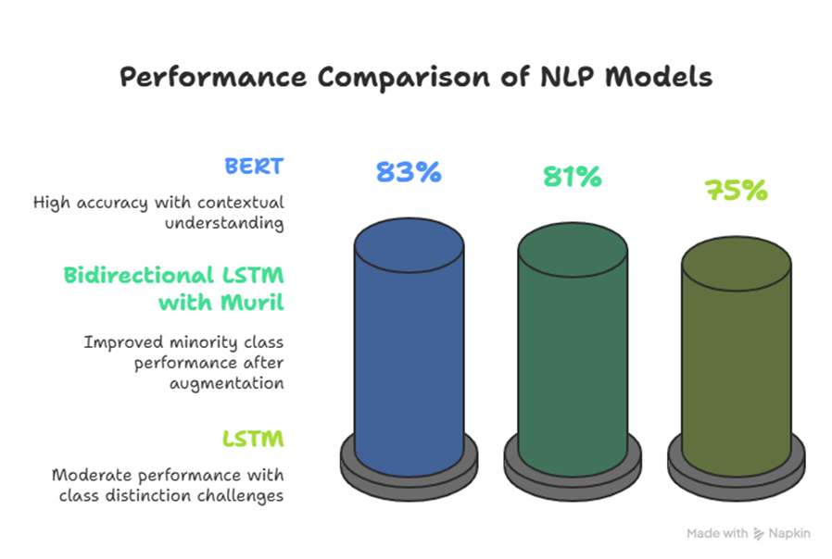

Slide 9
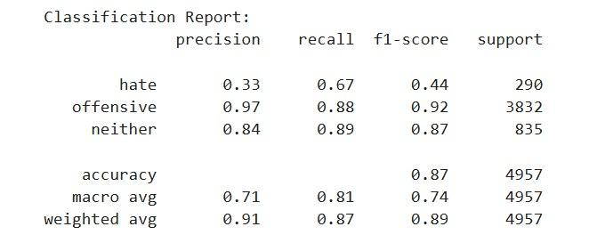
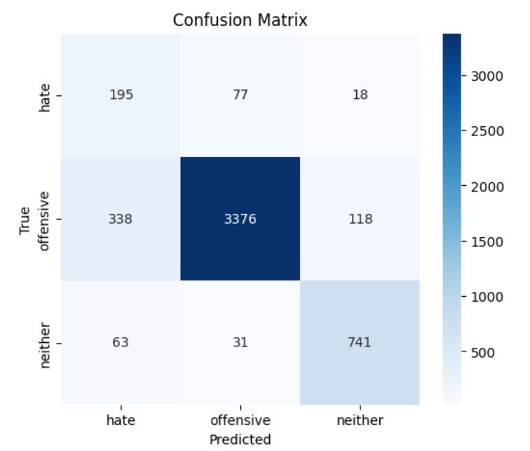
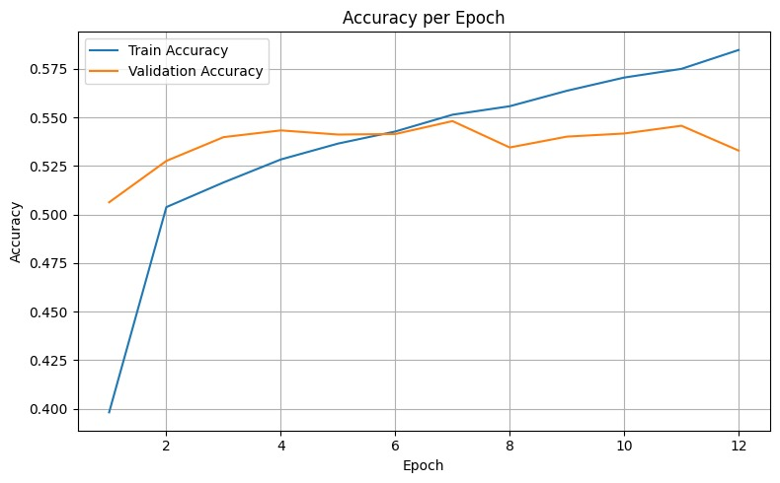

Slide 10
